Slide 1
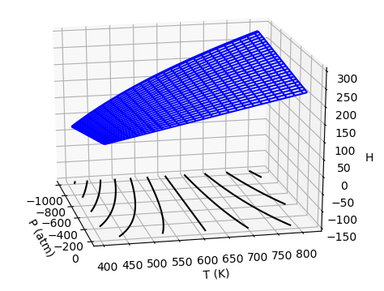


$$μ_{T}>0$$
$$μ_{T}<0$$

Slide 2


Critical behavior of real gases …
Isothermal compression below and above the critical temperature
$$T<T_{c}$$
$$T>T_{c}$$
gas
gas
Super-critical Gas/
Liquid
gas
liquid
liquid
liquid

Slide 3
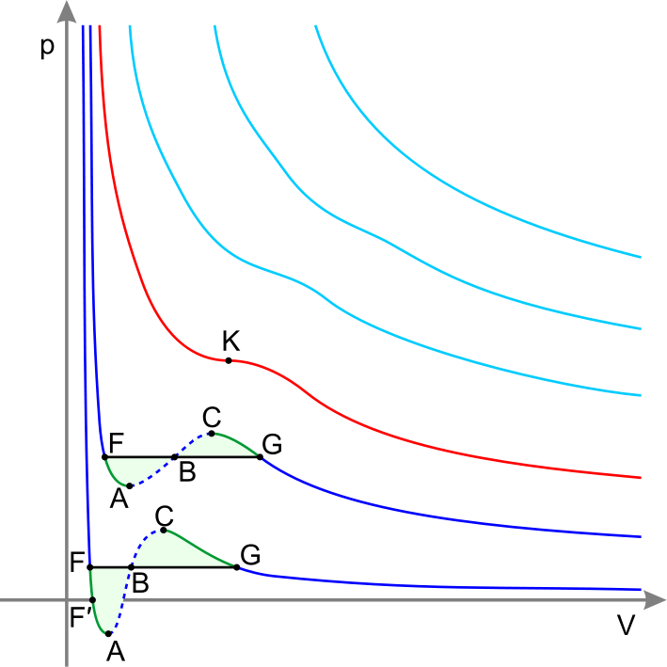




Critical behavior of real gases …
Isothermal compression in an indicator diagram
$$T>T_{c}$$
$$T=T_{c}$$
$$T<T_{c}$$
Just look at the horizontal lines below $T_{c}$

Slide 4
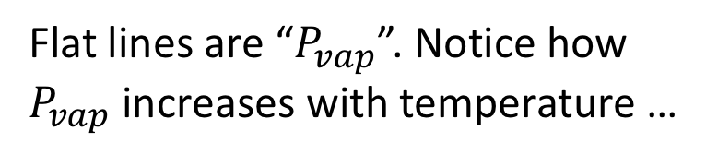

Critical point/vdw theory
We can even get $P_{vap}$ out of this …
Flat lines are “$P_{vap}$”. Notice how $P_{vap}$ increases with temperature …

Slide 5
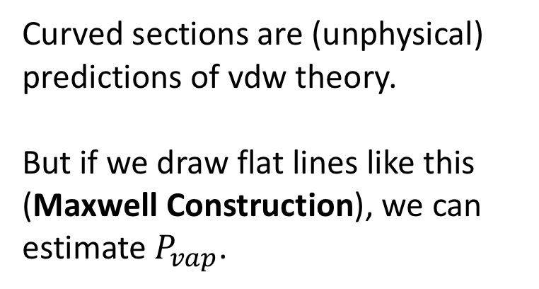
Maxwell Construction
We can even get $P_{vap}$ out of this …
Curved sections are (unphysical) predictions of vdw theory.
But if we draw flat lines like this (Maxwell Construction), we can estimate $P_{vap}$.

Slide 6
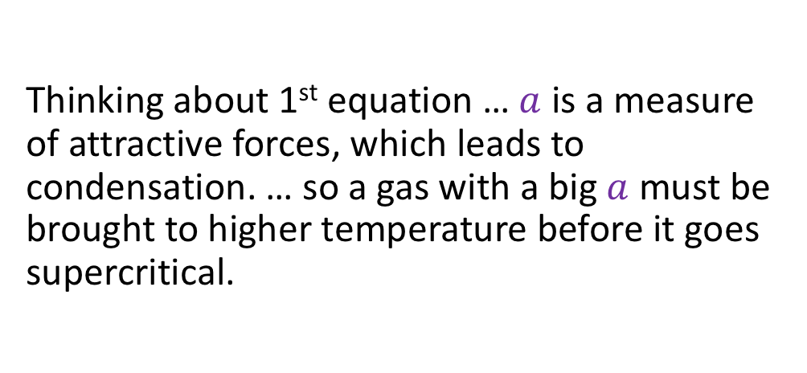
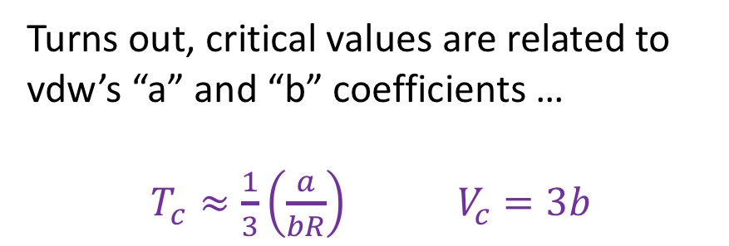
Analytical properties of vdw equation
Turns out, critical values are related to vdw’s “a” and “b” coefficients …
$T_{c}≈\frac{1}{3}\left(\frac{a}{bR}\right)$ $V_{c}=3b$
Thinking about 1st equation … $a$ is a measure of attractive forces, which leads to condensation. … so a gas with a big $a$ must be brought to higher temperature before it goes supercritical.

Slide 7
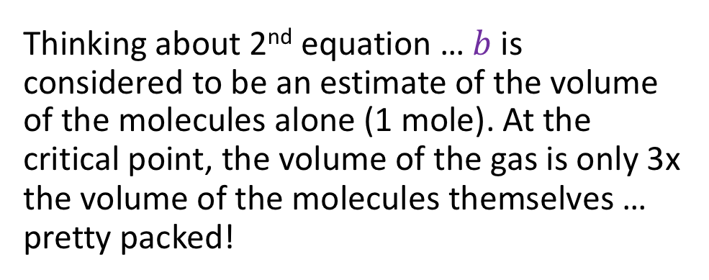
Analytical properties of vdw equation
Turns out, critical values are related to vdw’s “a” and “b” coefficients …
$T_{c}≈\frac{1}{3}\left(\frac{a}{bR}\right)$ $V_{c}=3b$
Thinking about 2nd equation … $b$is considered to be an estimate of the volume of the molecules alone (1 mole). At the critical point, the volume of the gas is only 3x the volume of the molecules themselves … pretty packed!

Slide 8
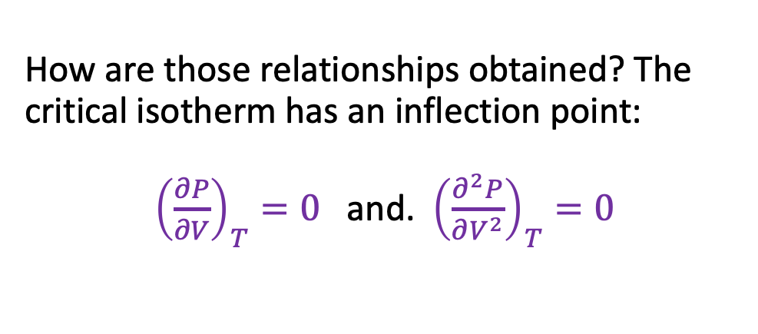
Getting 𝑻_{𝒄rit} and 𝑽_{𝒄rit} from a and b
How are those relationships obtained? The critical isotherm has an inflection point:
${\left(\frac{∂P}{∂V}\right)}_{T}=0$ and. ${\left(\frac{∂^{2}P}{∂V^{2}}\right)}_{T}=0$

Slide 9
What we learned …
Isothermal compression of a gas above the critical temperature is quite different from compression below the critical temperature
Critical values can be derived from vdw’s “a” and “b” coefficients

